Slide 1
Chapter 6: CPU Scheduling

Slide 2
Chapter 6: CPU Scheduling
Basic Concepts
Scheduling Criteria
Scheduling Algorithms
Thread Scheduling
Multiple-Processor Scheduling
Real-Time CPU Scheduling
Operating Systems Examples
Algorithm Evaluation

Slide 3

Objectives
To introduce CPU scheduling, which is the basis for multiprogrammed operating systems
To describe various CPU-scheduling algorithms
To discuss evaluation criteria for selecting a CPU-scheduling algorithm for a particular system
To examine the scheduling algorithms of several operating systems

Slide 4
Basic Concepts
Maximum CPU utilization obtained with multiprogramming
CPU–I/O Burst Cycle – Process execution consists of a cycle of CPU execution and I/O wait
CPU burst followed by I/O burst
CPU burst distribution is of main concern

Slide 5
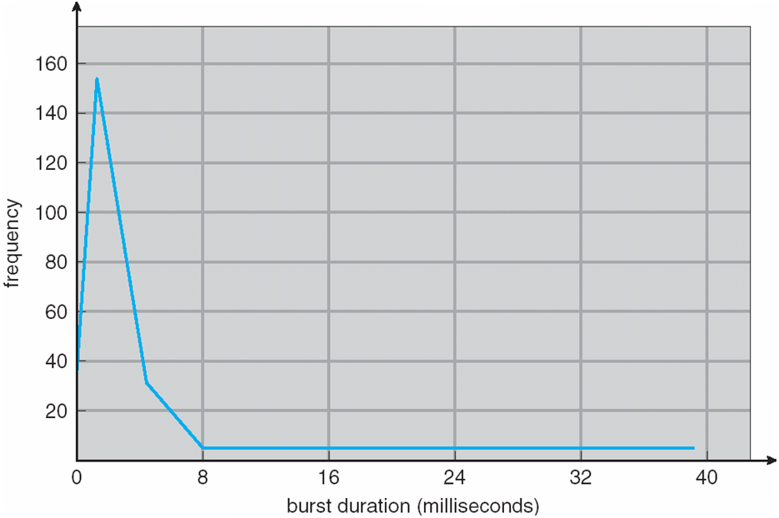
Histogram of CPU-burst Times
I/O-bound programs
CPU-bound programs

Slide 6
CPU Scheduler
Short-term scheduler selects from among the processes in ready queue, and allocates the CPU to one of them
Queue may be ordered in various ways (FIFO, Priority, Tree, Unordered) and usually contains process PCBs
CPU scheduling decisions may take place when a process:
1. Switches from running to waiting state (I/O request, child termination)
2. Switches from running to ready state (when interrupt occurs)
Switches from waiting to ready (when I/O completes)
Terminates
Scheduling ONLY under 1 and 4 is nonpreemptive or cooperative
Once the CPU has been allocated to a process, the process keeps the CPU until it decides to release it.

Slide 7

CPU Scheduler
All other scheduling is preemptive
Consider access to shared data (left in inconsistent state)
(been there, done that in Chapter 5)
Consider preemption while in kernel mode (incomplete changes)
Consider interrupts occurring during crucial OS activities
Critical sections of kernel (OS) code that would suffer if interrupted will disable interrupts on entry and enable interrupts on exit. (these occur infrequently and contain few instructions)

Slide 8
Dispatcher
Dispatcher module gives control of the CPU to the process selected by the short-term scheduler.
This involves:
switching context
switching to user mode
jumping to the proper location in the user program to restart that program
Dispatch Latency – time it takes for the dispatcher to stop one process and start another running.
Dispatchers should be fast to minimize Dispatch latency.

Slide 9
Scheduling Criteria
There are many criteria for comparing scheduling algorithms
CPU utilization – keep the CPU as busy as possible (40-90%)
Throughput – # of processes that complete their execution per time unit
Turnaround time – amount of time to execute a particular process (sum of wait times to enter memory, be on ready queue, execute on CPU, wait on I/O). Turnaround time is generally a function of the speed of the output device. Why?
Waiting time – amount of time a process has been waiting in the ready queue
Response time – amount of time it takes from when a request was submitted until the first response is produced, not the time it takes to output the response (for time-sharing environment).
Do you understand the difference between Turnaround Time and Response Time?

Slide 10

Scheduling Algorithm Optimization Criteria
Maximize CPU utilization
Maximize throughput
Minimize turnaround time
Minimize waiting time
Minimize response time
Some real world criteria
Minimize response time variance
“when I hit ‘Enter’ it ALWAYS takes 60 seconds” is more acceptable than “you never know how long it will take to respond”

Slide 11
First- Come, First-Served (FCFS) Scheduling
Process CPU Burst Time
P₁ 24
P₂ 3
P₃ 3
Suppose that the processes arrive in the order: P₁ , P₂ , P₃ The Gantt Chart for the schedule is:
Waiting time for P₁ = 0; P₂ = 24; P₃ = 27
Average waiting time: (0 + 24 + 27)/3 = 17
Remember: Scheduling deals with choosing which process on the ready queue should ‘get’ the CPU.

Slide 12
FCFS Scheduling (Cont.)
Suppose that the processes arrive in the order:
P₂ , P₃ , P₁
The Gantt chart for the schedule is:
Waiting time for P₁ = 6; P₂ = 0; P₃ = 3
Average waiting time: (6 + 0 + 3)/3 = 3
Much better than previous case
BUT the average wait time is NOT minimal and is sensitive to variance in CPU burst times of processes.
Remember: FCFS Scheduling is nonpreemptive. Not suitable for timesharing systems. Why not?

Slide 13
FCFS and the Convoy Effect
One CPU-bound process (A) and many I/O bound processes
Process A gets and holds the CPU
All other process complete their I/O and enter ready queue
I/O devices are idle.
Process A finishes long CPU burst and moves to short I/O burst.
I/O bound processes complete their short CPU bursts and move to I/O queues.
CPU is idle.
Process A gets the CPU and keeps it while the other processes wait.
If only the I/O bound processes had gone first…

Slide 14

Shortest-Job-First (SJF) Scheduling
Associate with each process the length of its next CPU burst
Use these lengths to schedule the process with the shortest time
FCFS breaks the tie in case two have equal times
SJF is optimal – gives minimum average waiting time for a given set of processes
The difficulty is knowing the length of the next CPU request
Could ask the user or her…….
A better name would be Shortest Next CPU Burst
Let’s look at an example and compare SJF with FCFS
SJF is a special case of the general priority-scheduling algorithm

Slide 15
Example of SJF
ProcessArriva l Time Burst Time
P₁ 0.0 6
P₂ 2.0 8
P₃ 4.0 7
P₄ 5.0 3
SJF scheduling is: P_{4,} P_{1,} P_{3,} P₂
Average waiting time = (3 + 16 + 9 + 0) / 4 = 7
Average waiting time under FCFS would have been 10.25

Slide 16

Determining Length of Next CPU Burst
Works best for long term scheduling and where users specify process time limits.
But we need a short-term scheduling algorithm!!
Can only estimate the length – should be similar to the previous one
Then pick process with shortest predicted next CPU burst
Can be done by using the length of previous CPU bursts

Slide 17
Prediction of the Length of the Next CPU Burst
= 1/2

Slide 18
Examples of Exponential Averaging
α =0
τ_{n+1} = τ_{n}
Recent history does not count
α =1
τ_{n+1} = α t_{n}
Only the actual last CPU burst counts
If we expand the formula, we get:
τ_{n+1} = α t_{n}+(1 - α)α t_{n} ₋₁ + …
+(1 - α )^{j} α t_{n} _{-j} + …
+(1 - α )^{n +1} τ₀
Since both α and (1 - α) are less than or equal to 1, each successive term has less weight than its predecessor

Slide 19
Preemptive SJF
The SJF algorithm can be preemptive or nonpreemptive.
The choice arises when a new process arrives at the ready queue while a process is still executing.
The next CPU burst of the newly arrived process may be shorter than what is left of the currently executing process.
A preemptive SJF algorithm will preempt the currently executing process
A nonpreemptive SJF algorithm will allow the currently executing process to finish its CPU burst.
Preemptive SJF is sometimes call Shortest Remaining Time First scheduling. Why?

Slide 20
Example of Shortest-remaining-time-first
Now we add the concepts of varying arrival times and preemption to the analysis
ProcessA arri Arrival TimeT Burst Time
P₁ 0 8
P₂ 1 4
P₃ 2 9
P₄ 3 5
Preemptive SJF Gantt Chart
Average waiting time = [(10-1)+(1-1)+(17-2)+(5-3)]/4 = 26/4 = 6.5 msec P₁ P₂ P₃ P₄
Average waiting time for Nonpreemptive SJF scheduling =7.75

Slide 21
Priority Scheduling
A priority number (integer) is associated with each process
The CPU is allocated to the process with the highest priority (smallest integer ≡ highest priority) (FCFS breaks ties)
Preemptive
Nonpreemptive
Major Problem is Indefinite Blocking or Starvation – low priority processes may never execute
Solution ≡ Aging – as time progresses increase the priority of the process (e.g., increment process priority by 1 every 15 minutes)
SJF is priority scheduling where priority is the inverse of predicted next CPU burst time

Slide 22
Example of Priority Scheduling
ProcessA arri Burst TimeT Priority
P₁ 10 3
P₂ 1 1
P₃ 2 4
P₄ 1 5
P₅ 5 2
Priority scheduling Gantt Chart
Average waiting time = 8.2 msec
How is the priority set?

Slide 23
Priority Types
Internal – use measurable quantity or quantities to compute priority
Time limits
Memory requirements
# of open files
Ratio of average I/O burst to average CPU burst
External – use criteria outside the operating system
Importance of process
Type and amount of funds being paid for computer use
Department sponsoring the work
Organizational politics

Slide 24
Round Robin (RR)
Designed for timesharing systems.
FCFS + preemption
Each process gets a small unit of CPU time (time quantum q), usually 10-100 milliseconds. After this time has elapsed, the process is preempted and added to the end of the ready (circular) queue.
If there are n processes in the ready queue and the time quantum is q, then each process gets 1/n of the CPU time in chunks of at most q time units at once. No process waits more than (n-1)q time units. Why?
Timer interrupts every quantum to schedule next process
Performance
If q large ⇒ FIFO/FCFS
If q small ⇒ q must be large with respect to context switch, otherwise overhead is too high

Slide 25
Example of RR with Time Quantum = 4
Process Burst Time
P₁ 24
P₂ 3
P₃ 3
The Gantt chart is:
Typically, higher average wait time than SJF, but better response
q should be large compared to context switch time Why?
q usually 10ms to 100ms, context switch < 10 usec
Average wait time in this scenario= 17/3 =5.66 milliseconds
P₁ waits 6ms (10-4); P₂ waits 4ms; P₃ waits 7ms; = 17

Slide 26
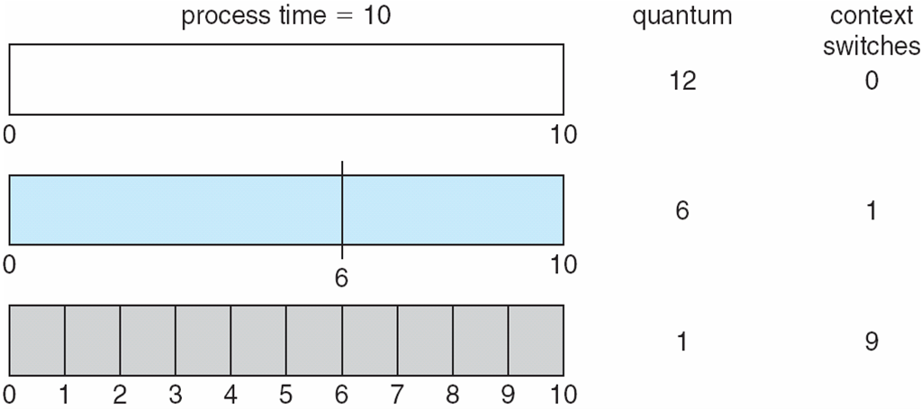
Time Quantum and Context Switch Time

Slide 27
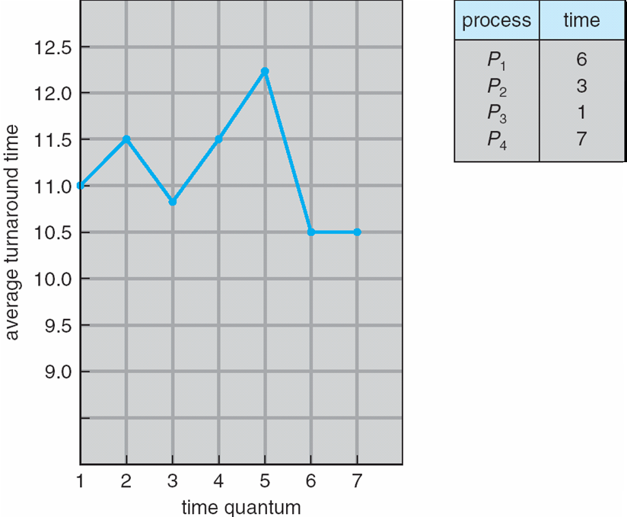
Turnaround Time Varies With The Time Quantum
80% of CPU bursts should be shorter than q
Average turnaround time does NOT necessarily improve as time-quantum size increases.

Slide 28
Multilevel Queue
Designed for situations where processes fit into different groups
Ready queue is partitioned into separate queues, e.g.:
foreground (interactive)
background (batch)
Process permanently in a given queue
Each queue has its own scheduling algorithm:
foreground – RR (why?)
background – FCFS
Scheduling must be done between the queues:
Fixed priority scheduling; (i.e., serve all from foreground then from background – including preemption!). Possibility of starvation.
Time slice – each queue gets a certain amount of CPU time which it can schedule amongst its processes
e.g., 80% to foreground in RR ; 20% to background in FCFS

Slide 29
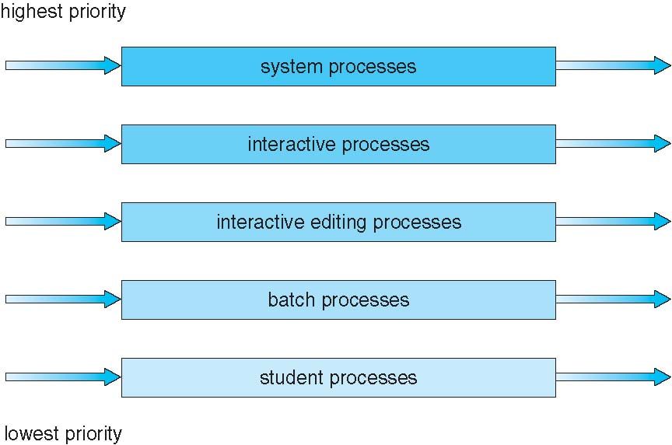

Multilevel Queue Scheduling
Absolute Priority or Time Slice Method among queues

Slide 30
Multilevel Feedback Queue
Processes are separated according to the characteristics of their CPU bursts.
A process can move between the various queues;
Use too much CPU and you get demoted.
Aging can be implemented this way
A process waiting too long in a lower-priority queue may be moved to higher priority queue.
Let’s look at an example

Slide 31
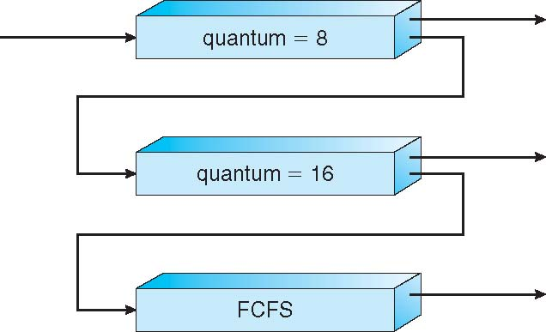
Example of Multilevel Feedback Queue
Three queues:
Q₀ – RR with time quantum 8 milliseconds
Q₁ – RR time quantum 16 milliseconds
Q₂ – FCFS
Scheduling
A new job enters queue Q₀ which is served
RR
When it gains CPU, job receives 8 milliseconds
If it does not finish in 8 milliseconds, job is moved to queue Q₁
At Q₁ job it receives 16 additional milliseconds
If it still does not complete, it is preempted and moved to queue Q₂

Slide 32
Multilevel Feedback Queue
Multilevel-feedback-queue scheduler defined by the following parameters:
number of queues
scheduling algorithms for each queue
method used to determine when to upgrade a process
method used to determine when to demote a process
method used to determine which queue a process will enter when that process needs service

Slide 33
Thread Scheduling
Distinction between user-level and kernel-level threads lies in how they are scheduled
When threads are supported, threads are scheduled, not processes
Many-to-one and many-to-many models, thread library schedules user-level threads to run on LWP
Known as process-contention scope (PCS) since scheduling competition is within the process
Typically done via priority set by programmer
Kernel thread scheduled onto available CPU using system-contention scope (SCS) – competition among all threads in system

Slide 34
Pthread Scheduling
API allows specifying either PCS or SCS during thread creation
PTHREAD_SCOPE_PROCESS schedules threads using PCS scheduling
PTHREAD_SCOPE_SYSTEM schedules threads using SCS scheduling
Can be limited by OS – Linux and Mac OS X only allow PTHREAD_SCOPE_SYSTEM

Slide 35
Pthread Scheduling API
#include <pthread.h>
#include <stdio.h>
#define NUM_THREADS 5
int main(int argc, char *argv[]) {
int i, scope; pthread_t tid[NUM THREADS];
pthread_attr_t attr;
/* get the default attributes */
pthread_attr_init(&attr);
/* first inquire on the current scope */ if (pthread_attr_getscope(&attr, &scope) != 0)
fprintf(stderr, "Unable to get scheduling scope\n");
else {
if (scope == PTHREAD_SCOPE_PROCESS)
printf("PTHREAD_SCOPE_PROCESS");
else if (scope == PTHREAD_SCOPE_SYSTEM)
printf("PTHREAD_SCOPE_SYSTEM");
else fprintf(stderr, "Illegal scope value.\n");
}

Slide 36
Pthread Scheduling API
/* set the scheduling algorithm to PCS or SCS */
pthread_attr_setscope(&attr, PTHREAD_SCOPE_SYSTEM);
/* create the threads */ for (i = 0; i < NUM_THREADS; i++)
pthread_create(&tid[i],&attr,runner,NULL);
/* now join on each thread */ for (i = 0; i < NUM_THREADS; i++)
pthread_join(tid[i], NULL);
}
/* Each thread will begin control in this function */
void *runner(void *param) {
/* do some work ... */
pthread_exit(0);
}

Slide 37
Multiple-Processor Scheduling
CPU scheduling more complex when multiple CPUs are available
Homogeneous processors within a multiprocessor
Asymmetric multiprocessing – only one processor accesses the system data structures, alleviating the need for data sharing
Symmetric multiprocessing (SMP) – each processor is self-scheduling, all processes in common ready queue, or each has its own private queue of ready processes
Currently, most common
Processor affinity – process has affinity for processor on which it is currently running
soft affinity
hard affinity
Variations including processor sets

Slide 38
NUMA and CPU Scheduling
Note that memory-placement algorithms can also consider affinity

Slide 39
Multiple-Processor Scheduling – Load Balancing
If SMP, need to keep all CPUs loaded for efficiency
Load balancing attempts to keep workload evenly distributed
Push migration – periodic task checks load on each processor, and if found pushes task from overloaded CPU to other CPUs
Pull migration – idle processors pulls waiting task from busy processor

Slide 40
Multicore Processors
Recent trend to place multiple processor cores on same physical chip
Faster and consumes less power
Multiple threads per core also growing
Takes advantage of memory stall to make progress on another thread while memory retrieve happens

Slide 41
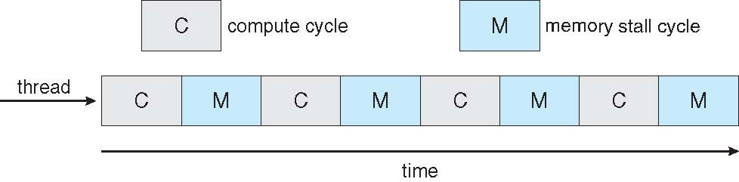
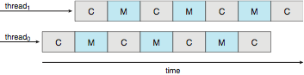
Multithreaded Multicore System

Slide 42
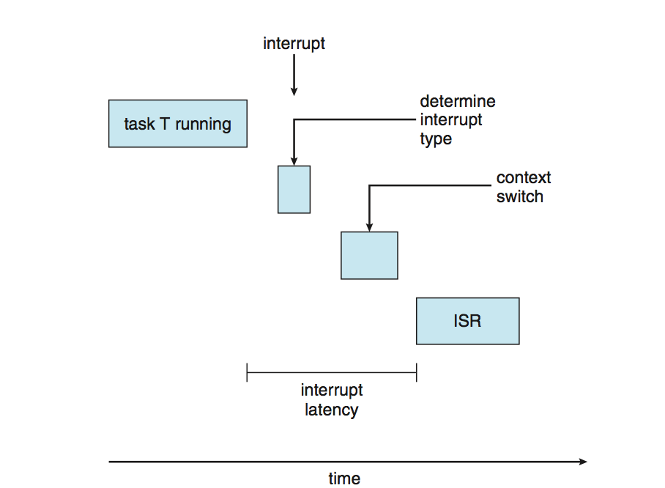
Real-Time CPU Scheduling
Can present obvious challenges
Soft real-time systems – no guarantee as to when critical real-time process will be scheduled except that it will be given preference over non-critical processes
Hard real-time systems – task must be serviced by its deadline
Two types of latencies affect performance
Interrupt latency – time from of interrupt arrival to start of interrupt services routine (ISR)
Dispatch latency – time for schedule to take current process off CPU and switch to another
Consider anti-lock brakes vs airline radar

Slide 43
Real-Time CPU Scheduling (Cont.)
Conflict phase of dispatch latency:
Preemption of any process running in kernel mode
Release by low-priority process of resources needed by high-priority processes
Preemptive kernels reduce dispatch latency from 100 milliseconds to <1 millisecond in Solaris.

Slide 44
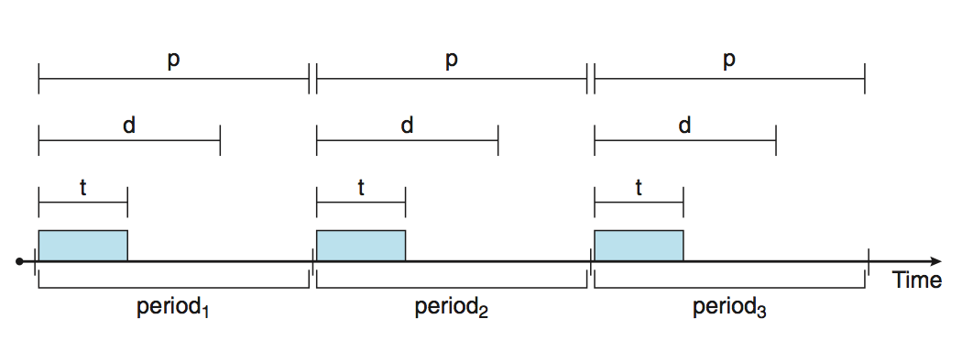
Priority-based Scheduling
For real-time scheduling, scheduler must support preemptive, priority-based scheduling
But only guarantees soft real-time
For hard real-time must also provide ability to meet deadlines and processes must announce their deadlines to the scheduler
Processes have new characteristics: periodic ones require CPU at constant intervals
Has processing time t, deadline d, period p
0 ≤ t ≤ d ≤ p
Rate of periodic task is 1/p

Slide 45

Priority-based Scheduling
Processes announce their deadline requirements to the scheduler.
Using an admission control algorithm, the scheduler either:
Admits the process, guaranteeing that the process will complete on time
Rejects the request as impossible if it cannot guarantee that the task will be serviced by its deadline.

Slide 46
Virtualization and Scheduling
Virtualization software schedules multiple guests onto CPU(s)
Each guest doing its own scheduling
Not knowing it doesn’t own the CPUs
Can result in poor response time
Can effect time-of-day clocks in guests
Can undo good scheduling algorithm efforts of guests

Slide 47
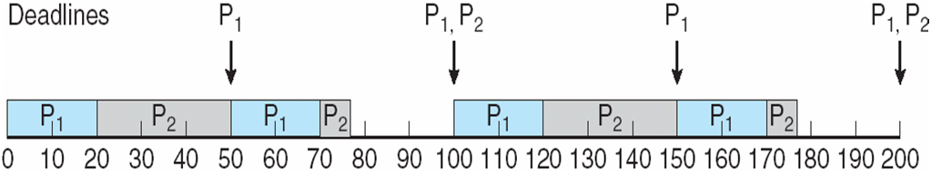
Rate Montonic Scheduling
A priority is assigned based on the inverse of its period
Shorter periods = higher priority;
Longer periods = lower priority
P₁ is assigned a higher priority than P₂.
p₁=50; p₂=100 t₁=20; t₂=35
Deadline=before next scheduled execution
RMS is static priority with preemption.
Assign higher priority to tasks that need the CPU more often.

Slide 48
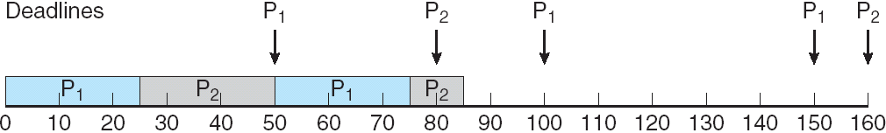
Missed Deadlines with Rate Monotonic Scheduling
P₂ misses deadline (80)
p₁=50; p₂=80 t₁=25; t₂=35
Deadline=before next scheduled execution
RMS worst case CPU utilization for scheduling two processes is ~83%. Combined CPU utilization for P₁ and P₂ is ~94%.
That’s why it fails here!!

Slide 49
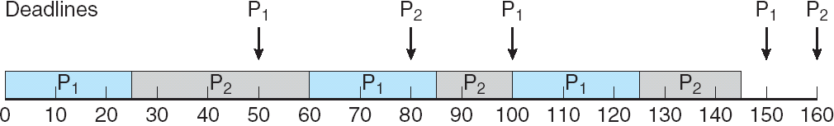
Earliest Deadline First Scheduling (EDF)
Priorities are assigned according to deadlines: the earlier the deadline, the higher the priority;
the later the deadline, the lower the priority
Priorities are not fixed
p₁=50; p₂=80 t₁=25; t₂=35
Deadline=before next scheduled execution
EDF requires neither periodicity nor constant CPU burst times.
The only requirement is that the process announce its deadline to the scheduler when it becomes runnable.

Slide 50
Proportional Share Scheduling
T shares are allocated among all processes in the system
An application receives N shares where N < T
This ensures each application will receive N / T of the total processor time
Cooperates with admission control policy to guarantee that an application receives its allocated shares of time.
Admission control will only admit an application if the requested number of shares are available.

Slide 51
POSIX Real-Time Scheduling
The POSIX.1b standard
API provides functions for managing real-time threads
Defines two scheduling classes for real-time threads:
SCHED_FIFO - threads are scheduled using a FCFS strategy with a FIFO queue. There is no time-slicing for threads of equal priority
SCHED_RR - similar to SCHED_FIFO except time-slicing occurs for threads of equal priority
Defines two functions for getting and setting scheduling policy:
pthread_attr_getsched_policy(pthread_attr_t *attr, int *policy)
pthread_attr_setsched_policy(pthread_attr_t *attr, int policy)

Slide 52
POSIX Real-Time Scheduling API
#include <pthread.h>
#include <stdio.h>
#define NUM_THREADS 5
int main(int argc, char *argv[])
{
int i, policy; pthread_t_tid[NUM_THREADS];
pthread_attr_t attr;
/* get the default attributes */
pthread_attr_init(&attr);
/* get the current scheduling policy */ if (pthread_attr_getschedpolicy(&attr, &policy) != 0)
fprintf(stderr, "Unable to get policy.\n");
else {
if (policy == SCHED_OTHER) printf("SCHED_OTHER\n");
else if (policy == SCHED_RR) printf("SCHED_RR\n");
else if (policy == SCHED_FIFO) printf("SCHED_FIFO\n");
}

Slide 53
POSIX Real-Time Scheduling API (Cont.)
/* set the scheduling policy - FIFO, RR, or OTHER */ if (pthread_attr_setschedpolicy(&attr, SCHED_FIFO) != 0)
fprintf(stderr, "Unable to set policy.\n");
/* create the threads */ for (i = 0; i < NUM_THREADS; i++)
pthread_create(&tid[i],&attr,runner,NULL);
/* now join on each thread */ for (i = 0; i < NUM_THREADS; i++)
pthread_join(tid[i], NULL);
}
/* Each thread will begin control in this function */
void *runner(void *param) {
/* do some work ... */
pthread_exit(0);
}

Slide 54
Operating System Examples
Linux scheduling
Windows scheduling
Solaris scheduling

Slide 55
Linux Scheduling Through Version 2.5
Prior to kernel version 2.5, ran variation of standard UNIX scheduling algorithm
Version 2.5 moved to constant order O(1) scheduling time
Preemptive, priority based
Two priority ranges: time-sharing and real-time
Real-time range from 0 to 99 and nice value from 100 to 140
Map into global priority with numerically lower values indicating higher priority
Higher priority gets larger q
Task run-able as long as time left in time slice (active)
If no time left (expired), not run-able until all other tasks use their slices
All run-able tasks tracked in per-CPU runqueue data structure
Two priority arrays (active, expired)
Tasks indexed by priority
When no more active, arrays are exchanged
Worked well, but poor response times for interactive processes

Slide 56
Linux Scheduling in Version 2.6.23 +
Completely Fair Scheduler (CFS)
Scheduling classes
Each has specific priority
Scheduler picks highest priority task in highest scheduling class
Rather than quantum based on fixed time allotments, based on proportion of CPU time
2 scheduling classes included, others can be added
default
real-time
%tage of CPU is allocated based on nice value from -20 to +19
Lower value is higher priority
Calculates target latency – interval of time during which task should run at least once
Target latency can increase if the number of active tasks increases beyond a specified threshold

Slide 57
Linux Scheduling in Version 2.6.23 +
Completely Fair Scheduler (CFS)
CFS scheduler maintains per task virtual run time in variable vruntime
Associated with decay factor based on priority of task – lower priority is higher decay rate
Lower priority task that runs for 200 milliseconds– vruntime is > 200 milliseconds
Higher priority task that runs for 200 milliseconds – vruntime is < 200 milliseconds
Normal default priority (nice = 0) yields virtual run time = actual run time
To decide next task to run, scheduler picks task with lowest virtual run time
Preemption is possible

Slide 58
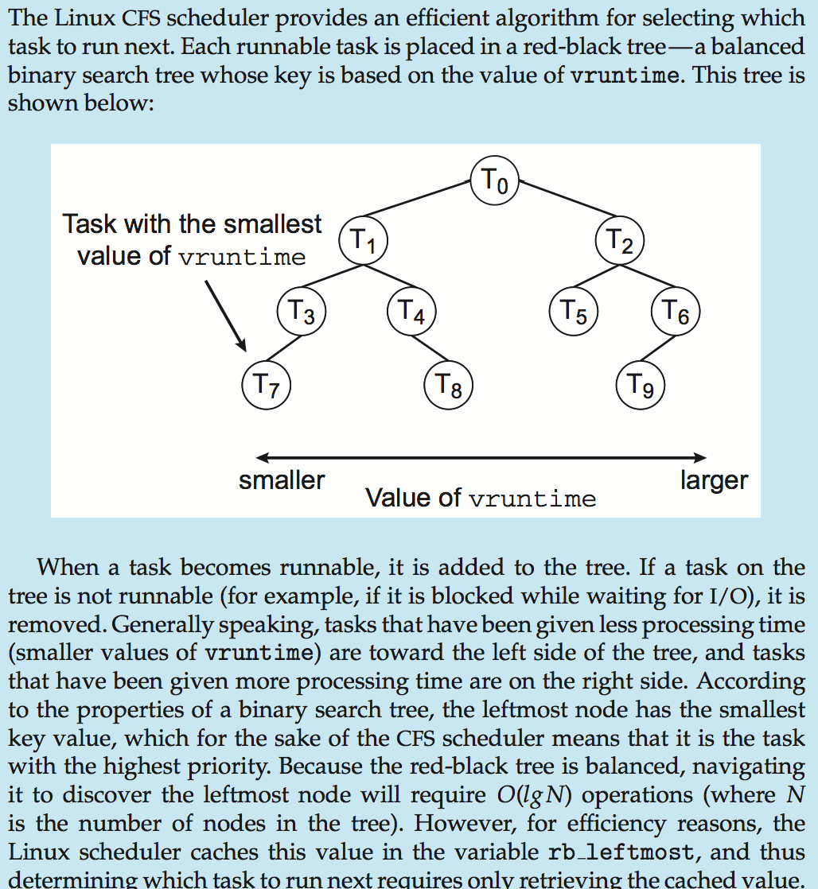
CFS Performance

Slide 59
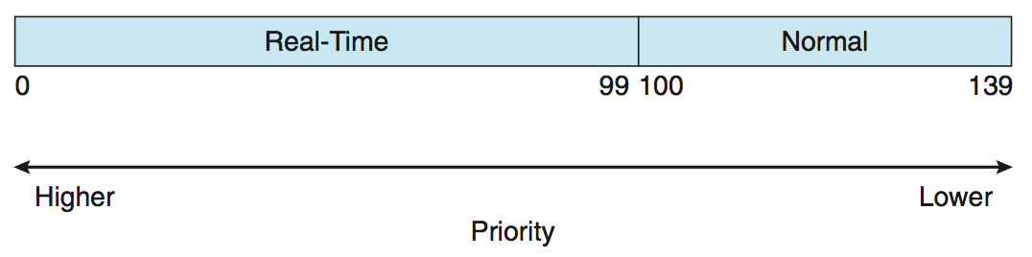
Linux Scheduling (Cont.)
Real-time scheduling according to POSIX.1b
Real-time tasks have static priorities
Real-time plus normal map into global priority scheme
Nice value of -20 maps to global priority 100
Nice value of +19 maps to priority 139

Slide 60
Windows Scheduling
Windows uses priority-based preemptive scheduling
Highest-priority thread runs next
Dispatcher is scheduler
Thread runs until (1) blocks, (2) uses time slice, (3) preempted by higher-priority thread
Real-time threads can preempt non-real-time
32-level priority scheme
Variable class is 1-15, real-time class is 16-31
Priority 0 is memory-management thread
Queue for each priority
If no run-able thread, runs idle thread (why bother?)

Slide 61
Windows Priority Classes
Win32 API identifies several priority classes to which a process can belong
REALTIME_PRIORITY_CLASS,
HIGH_PRIORITY_CLASS, ABOVE_NORMAL_PRIORITY_CLASS,
NORMAL_PRIORITY_CLASS,
BELOW_NORMAL_PRIORITY_CLASS,
IDLE_PRIORITY_CLASS
All are variable except REALTIME
A thread within a given priority class has a relative priority
TIME_CRITICAL,
HIGHEST,
ABOVE_NORMAL,
NORMAL,
BELOW_NORMAL,
LOWEST,
IDLE

Slide 62
Windows Priority Classes (Cont.)
Priority class and relative priority combine to give numeric priority
Base priority is NORMAL within the class
If quantum expires, priority lowered, but never below base (if in a variable-priority class)
If wait occurs, priority boosted depending on what was waited for
Keyboard I/O wait gets a bigger boost than disk operation wait
This keeps interactive thread with good response times.
Foreground window given 3x priority boost
Windows 7 added user-mode scheduling (UMS)
Applications create and manage threads independent of kernel
For large number of threads, much more efficient
UMS schedulers come from programming language libraries like C++ Concurrent Runtime (ConcRT) framework

Slide 63
Windows Priorities

Slide 64
Solaris
Priority-based scheduling
Six classes available
Time sharing (default) (TS)
Interactive (IA)
Real time (RT)
System (SYS) – reserved for kernel use
Fair Share (FSS) - uses shares instead of priorities for scheduling
Fixed priority (FP) – priorities not dynamically adjusted
Given thread can be in one class at a time
Each class has its own scheduling algorithm
Time sharing is multi-level feedback queue dynamically altering priorities and assigns time-slices of different lengths
Loadable table configurable by sysadmin

Slide 65
Solaris Dispatch Table
low
high
Inversely related

Slide 66
Solaris Scheduling
10

Slide 67
Solaris Scheduling (Cont.)
Scheduler converts class-specific priorities into a per-thread global priority
Thread with highest priority runs next
Runs until (1) blocks, (2) uses time slice, (3) preempted by higher-priority thread
Multiple threads at same priority selected via RR

Slide 68
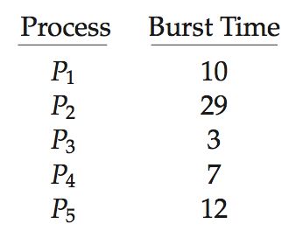
Algorithm Evaluation
How to select CPU-scheduling algorithm for an OS?
Determine criteria, then evaluate algorithms
Deterministic modeling
Type of analytic evaluation
Takes a particular predetermined workload and defines the performance of each algorithm for that workload
Consider 5 processes arriving at time 0:

Slide 69
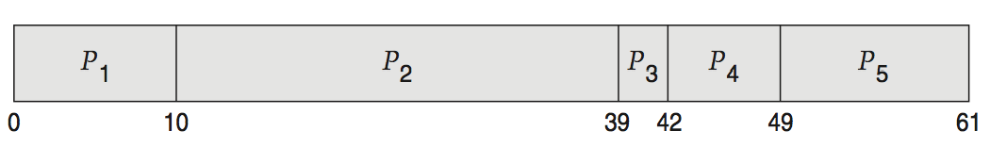
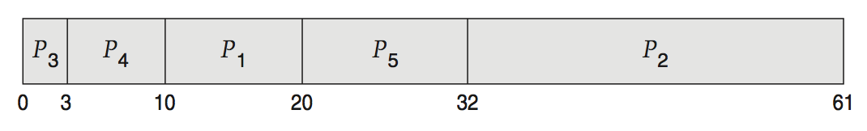
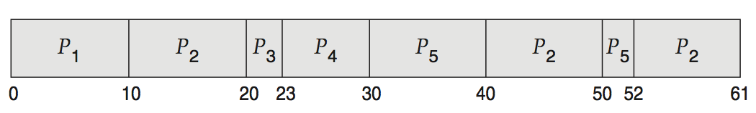
Deterministic Evaluation
For each algorithm, calculate minimum average waiting time
Simple and fast, but requires exact numbers for input, applies only to those inputs
FCS is 28ms:
Non-preemptive SFJ is 13ms:
RR is 23ms:

Slide 70
Queueing Models
Describes the arrival of processes, and CPU and I/O bursts probabilistically
Commonly exponential, and described by mean
Computes average throughput, utilization, waiting time, etc
Computer system described as network of servers, each with queue of waiting processes
Knowing arrival rates and service rates
Computes utilization, average queue length, average wait time, etc

Slide 71
Little’s Formula
n = average queue length
W = average waiting time in queue
λ = average arrival rate into queue
Little’s law – in steady state, processes leaving queue must equal processes arriving, thus: n = λ x W
Valid for any scheduling algorithm and arrival distribution
For example, if on average 7 processes arrive per second, and normally 14 processes in queue, then average wait time per process = 2 seconds

Slide 72
Simulations
Queueing models limited
Simulations more accurate
Programmed model of computer system
Clock is a variable
Gather statistics indicating algorithm performance
Data to drive simulation gathered via
Random number generator according to probabilities
Distributions defined mathematically or empirically
Trace tapes record sequences of real events in real systems

Slide 73
Evaluation of CPU Schedulers by Simulation

Slide 74
Implementation
Even simulations have limited accuracy
Just implement new scheduler and test in real systems
High cost, high risk
Environments vary
Most flexible schedulers can be modified per-site or per-system
Or APIs to modify priorities
But again environments vary

Slide 75
End of Chapter 6

